Slide 1

Global Energy Consumption and Economic Indicators Analysis
Presented by:
Manasa Siripurapu

Slide 2



Energy Consumption, Production & Emission Analysis - A Global Data Study
Understanding global energy patterns and their connection to economic power, population and emissions.

Slide 3

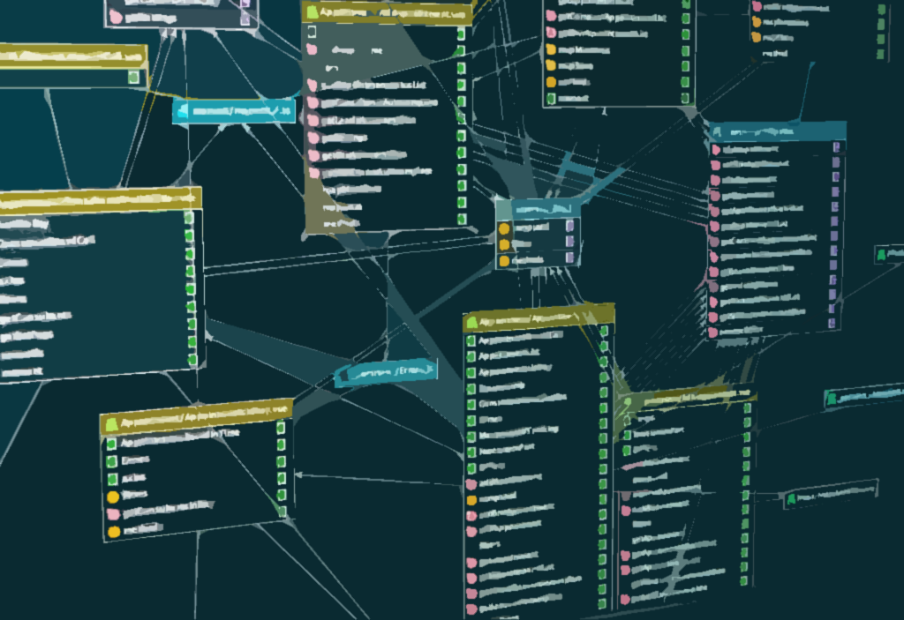

Introduction
The Global Energy and Environment domain requires effective analysis of energy production, consumption, population, GDP, and emissions across countries.
Accurate data assessment helps identify high-consumption regions, measure emission levels, evaluate economic growth, and track sustainability progress.
This project simulates a multi-country energy database with interconnected tables such as country, consumption, production, gdp, population, and emissions.
It provides hands-on experience in understanding data relationships, temporal trends, and cross-country comparisons.
Students will use SQL queries to extract insights, detect patterns, and study correlations between energy usage and economic indicators.
The goal is to strengthen data-driven decision-making for climate action, sustainable energy policies, and economic planning.

Slide 4
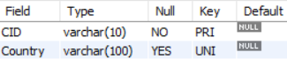
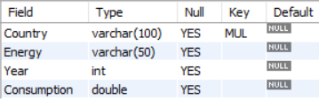
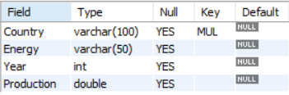
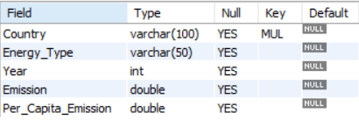
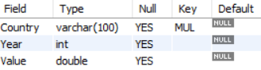
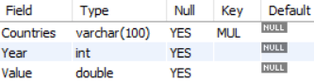
Database Tables Overview
EnergyConsumptionDB - the central database that holds all energy and economic data tables used in this project.
Country Table
Consumption Table
Production Table
Emission Table
GDP Table
Population Table

Slide 5
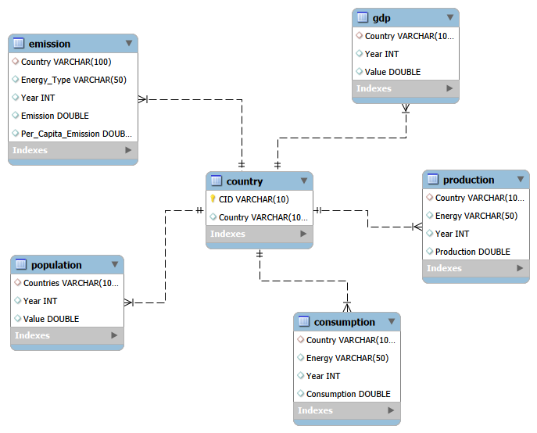
ER Diagram - Energy Consumption Database
The ER Diagram represents the relational structure of the EnergyConsumptionDB, where the Country table acts as the central dimension and connects to all other data tables through foreign-key relationships, forming a one-to-many relational schema for global energy analysis.

Slide 6
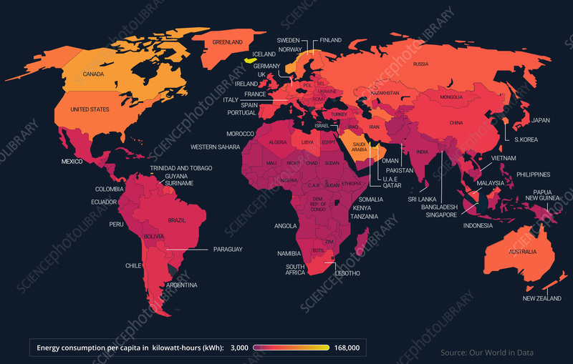
Problem Statement
In the rapidly evolving global energy landscape, analysing large volumes of data related to energy consumption, production, emissions, GDP, and population across countries is essential for understanding economic progress and environmental impact. This project aims to build a relational database system that integrates multi-country energy datasets and enables users to perform detailed analytical queries to uncover meaningful insights. The analysis focuses on identifying patterns such as rising or declining energy demand, the relationship between economic growth and emissions, population-driven consumption trends, and the contribution of different energy types to global emissions. The overall objective is to support data-driven understanding of how energy usage influences development, sustainability, and climate outcomes across nations.

Slide 7
General & Comparative Analysis

Slide 8
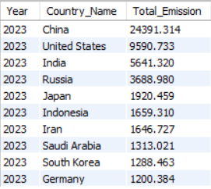
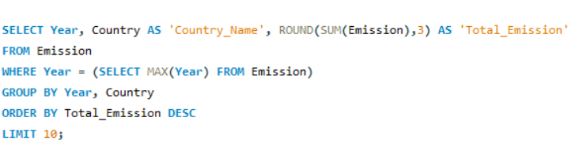
1. What are the top 10 countries with the highest total emissions in the most recent year available?

Slide 9
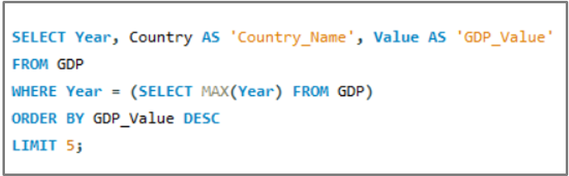
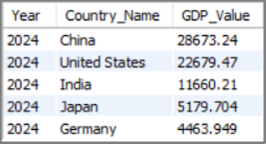
2. What are the top 5 countries by GDP in the most recent year?

Slide 10
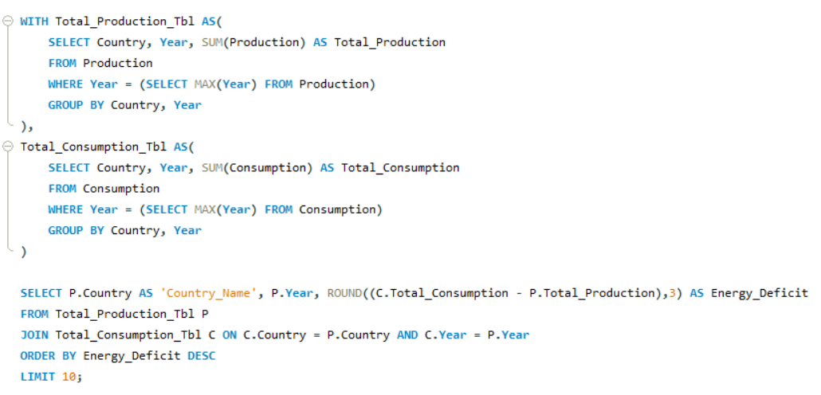
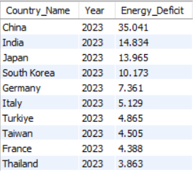
3. Which countries have the highest energy deficit in the most recent year?

Slide 11
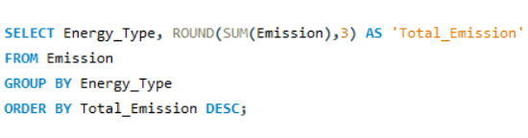
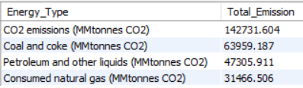
4. Which energy types contribute the most to total global emissions across all countries?

Slide 12
Trend Analysis Over Time

Slide 13
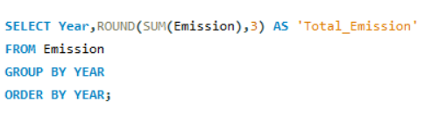
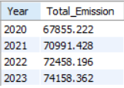
5. How have global emissions changed year over year?

Slide 14
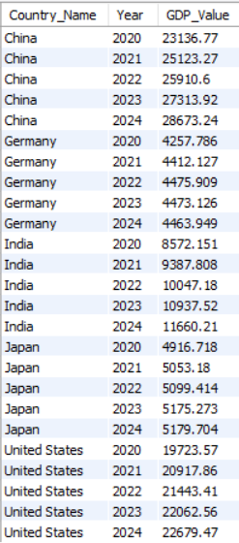
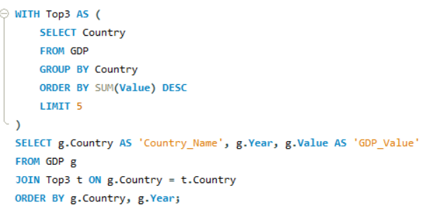
6. What is the GDP trend over the years for the top 5 highest-GDP countries?

Slide 15
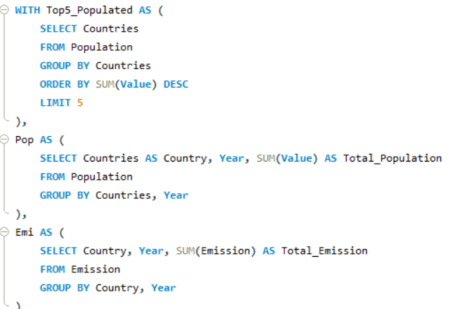
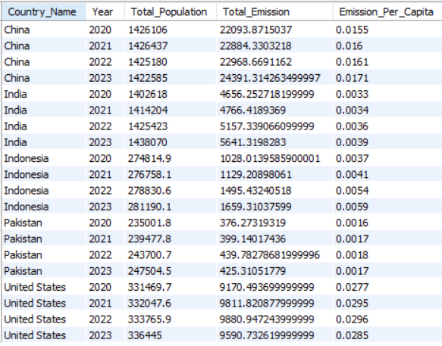
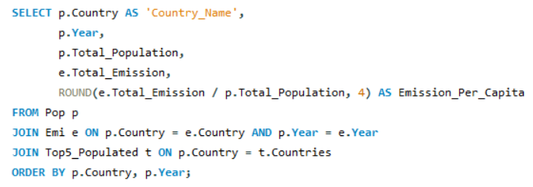
7. How has population growth affected total emissions over time for the top 5 most populated countries?

Slide 16
Ratio & Per Capita Analysis

Slide 17
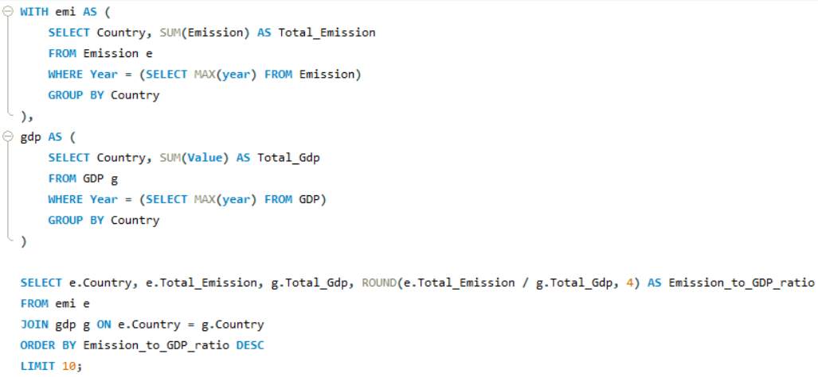
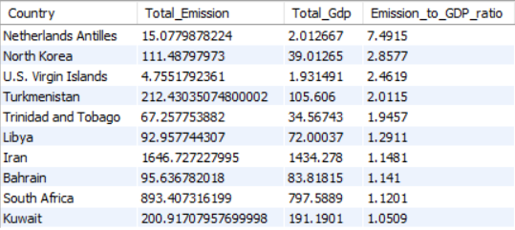
8. Which 10 countries have the highest emission-to-GDP ratio in the most recent year?

Slide 18
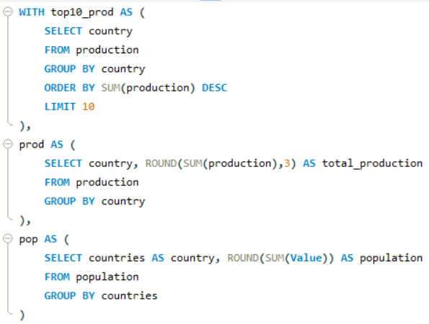
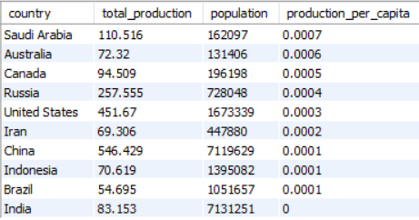
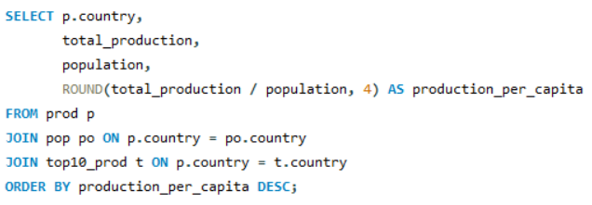
9. How does energy production per capita vary among the top 10 energy-producing nations?

Slide 19
Global Comparisons

Slide 20
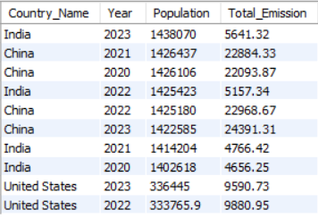
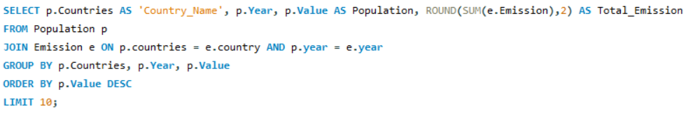
10. Which are the top 10 most populated countries, and how do their total emissions compare

Slide 21
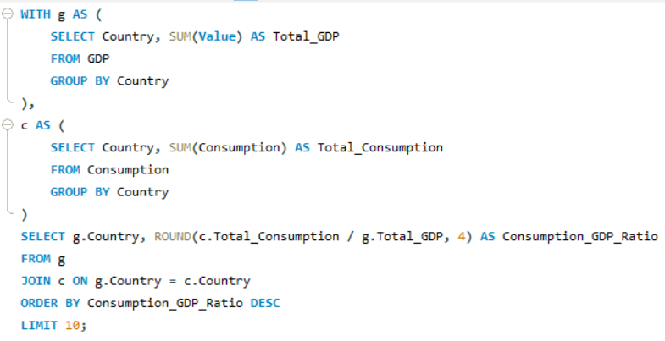
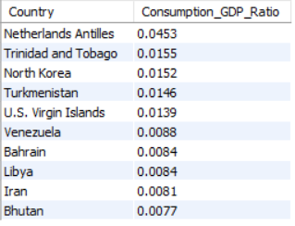
11. Which 10 countries have the highest energy consumption relative to their GDP

Slide 22
THANK YOU

